Slide 1
A Flexible Wildcard-Pattern Matching Accelerator via Simultaneous Discrete Finite Automata
Author: Hsiang-Jen Tsai, Chien-Chih Chen, Yin-Chi Peng,
Ya-Han Tsao, Yen-Ning Chiang, Wei-Cheng Zhao, Meng-Fan Chang
Presenter: Yi-Hsien Wu
Conference : IEEE TRANSACTIONS ON VERY LARGE SCALE INTEGRATION (VLSI) SYSTEMS, VOL. 25, NO. 12, DECEMBER 2017
Date: 2017/12/06
Department of Computer Science and Information Engineering
National Cheng Kung University, Taiwan R.O.C.
Notes:
1

Slide 2
Outline
Introduction
Proposed Scheme
Results and Analysis
Conclusion

Slide 3
Introduction
Recently, ternary content addressable memory (TCAM) based search engines have been used to implement regular expression matching algorithms to utilize their parallel comparison and “don’t care (X)” search abilities to achieve high
speeds.
Detecting the match of unpredictable input strings in wildcard patterns is in fact the most critical challenge because the nondeterministic nature of wildcard
patterns results in a large number of possible match.
Notes:
近期因為ruleset size快速成長，因此ruleset複雜度造成一般封包分類方法memory表現很差
Swintop是一種將ruleset去分類的方式

Slide 4
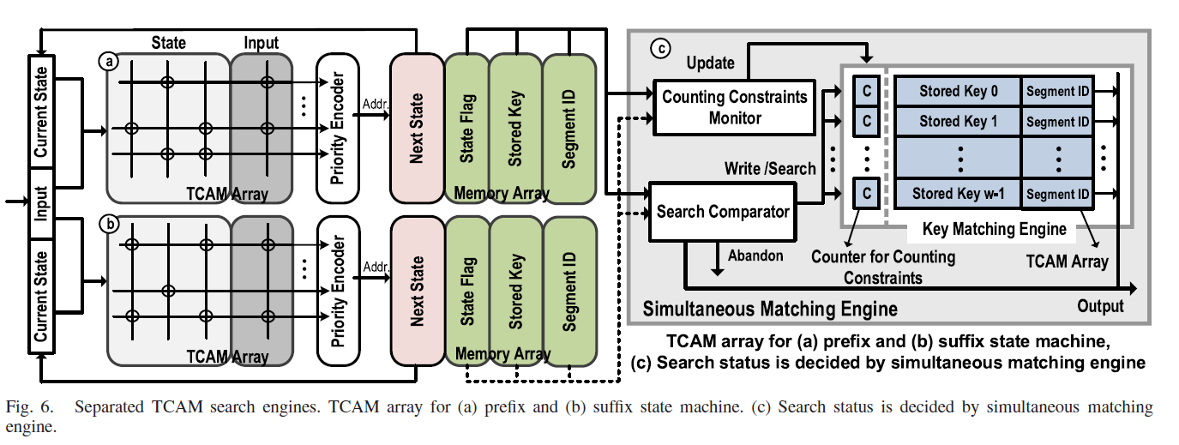
Proposed Scheme
The proposed separated TCAM search engine consists of three major
components, which includes two small isolated TCAM search engines and a simultaneous matching engine.

Slide 5
Proposed Scheme (Components)
Search comparator
It is used to determine the actions of the key according to the state of the flag, where the states include abandon, search, write, or out-match.
Key matching engine
It is used to store the key and compare the stored key with the search key in a TCAM array.
For wildcard pattern matching, the corresponding key of the accept state (stored key) will be stored for the next operation, which is the match case of the prefix state machine.
On the other hand, the corresponding key of the accept state in the match case of the suffix state machine (search key) is used to search the stored key in the simultaneous matching engine.

Slide 6
Proposed Scheme (Components)
Counting constraints monitor
It updates the counter of the stored key according to the state flag.
We define a counter in the key matching engine to serve as the counting constraints of each stored key, which limits the lifetime of wildcard patterns that is recognized.
When the counter of the stored key does not equal zero, the counter is decremented for the counting constraints.
If the counter of the stored key equals zero, the engine makes space for the incoming stored key by evicting this key.
Segment ID
It is used to ensure that each segment of a multi-wildcard pattern is sequentially matched in the input strings.

Slide 7
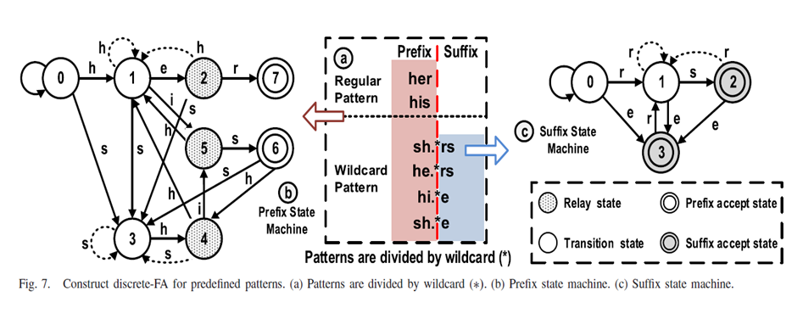
Proposed Scheme

Slide 8
Proposed Scheme

Slide 9
Proposed Scheme

Slide 10
Proposed Scheme

Slide 11
Proposed Scheme

Slide 12
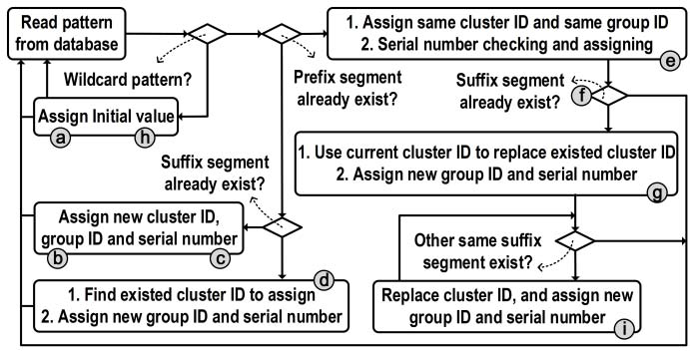
Proposed Scheme
Key assignment flow of the cluster encode

Slide 13
Proposed Scheme

Slide 14
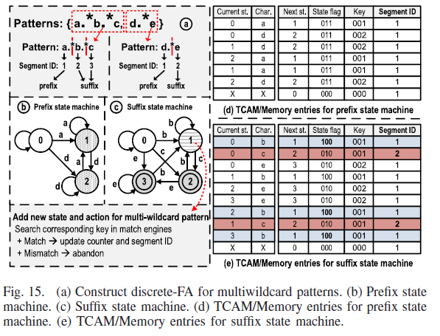
Proposed Scheme
To recognize multi-wildcard patterns, the proposed architecture is needed to modify with a minor extension.

Slide 15
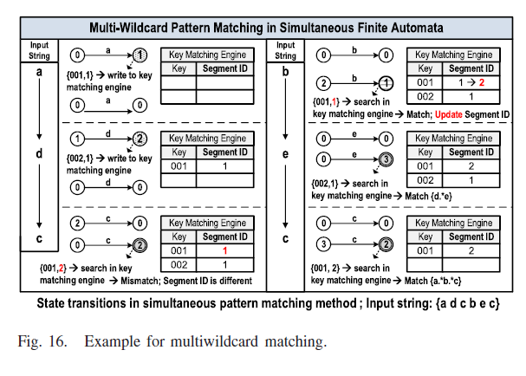
Proposed Scheme

Slide 16
Results and Analysis
We implemented a synthetic workload generator to generate several workloads, which is based on BigDataBench .
BigDataBench includes several big data workloads with varying data inputs, which not only covers broad application scenarios but also includes diverse data
sets.
Also, we extracted patterns from a ClamAV antivirus database, and then inserted to the workloads for evaluating the proposed design, including 1518 wildcard patterns and 28862 regular patterns

Slide 17
Results and Analysis

Slide 18
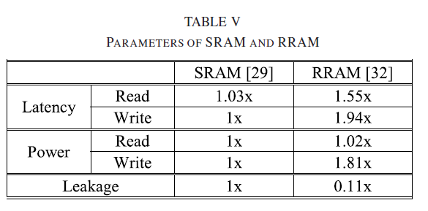
Results and Analysis

Slide 19
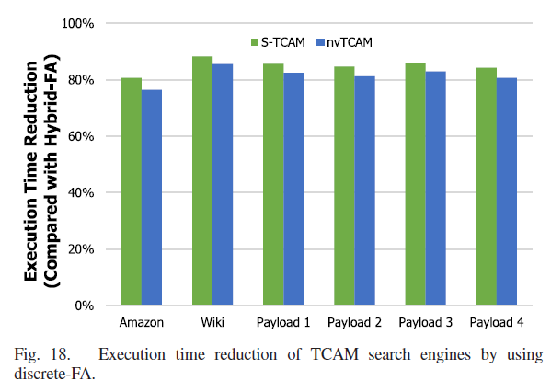
Results and Analysis

Slide 20
Conclusion
This paper proposes an efficient separated search engine based on the detailed analysis of wildcard pattern properties.
It indicates that two active states with two transitions are sufficient for wildcard-pattern matching problems.
A simple architecture modification based on simultaneous matching methodology is proposed as an alternative.
This exhibits accurate traversal and traverses all possible matches by two
separated engines to represent discrete-FA.
We used the cluster encoding method to resolve problems of ambiguity and key
size for the simultaneous pattern matching method.
In our experimental results, we only needed a small sized TCAM array in the key matching engine for various applications in the proposed design.

